Slide 1
Final Project
Lightning Talk
Yuka Abe 12/12/2017

Slide 2
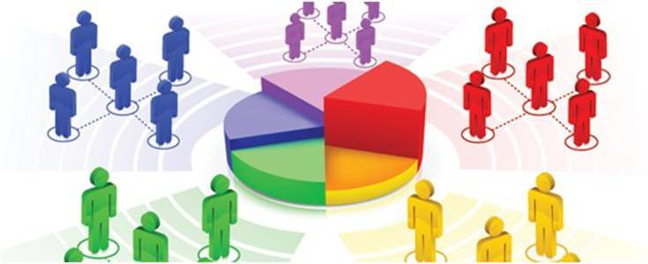
Problem Statement:
IDEA ONE: E-Commerce Data for UK online retailer
Goal: Classify the customer base and identify opportunities within each customer segment
Timeframe: 1/12/2010 to 9/12/2011
Transactional data from a UK-based non-store online retail business
Product: all-occasion gifts, Customer base: wholesalers
Dataset:
InvoiceNo | StockCode | Description | Quantity | InvoiceDate | UnitPrice | CustomerID | Country
536365 | 71053 | WHITE METAL LANTERN | 6 | 12/1/10 8:26 | 3.39 | 17850 | United Kingdom
Solution:
Clustering Model
Notes:
Idea 1: Analyze the Ecommerce data for a UK retailer
Problem statement:
The dataset I’m going to use is a transactional data from a UK based non-store online retail store. The company sells unique all-occasion gifts. Many of the store’s customers are wholesalers.
The questions that I need to answer after the data analysis is
- Do all customers look the same? Are they different? If they are different, what’s the difference? How to classify them? Which type of customers are the most profitable? What do the best customers look like?
The goal is to analyze the Ecommerce transaction data for a UK-based and registered non-store online retailer to classify the current customer base, identify marketing opportunities within each defined customer segment and leverage the learning on the best customers for acquiring look-alike prospects
Outcome of the analysis: What customer segment does this particular customer belong to and the buying patterns and characteristics of the customer segments.
Timeframe of the analysis: 1/12/2010 – 9/12/2011
Dataset:
Solution: Classification Model
Idea 1: Analyze the Ecommerce data for a UK retailer
Problem statement:
The dataset I’m going to use is a transactional data from a UK based non-store online retail store. The company sells unique all-occasion gifts. Many of the store’s customers are wholesalers.
The questions that I need to answer after the data analysis is
- Do all customers look the same? Are they different? If they are different, what’s the difference? How to classify them? Which type of customers are the most profitable? What do the best customers look like?
The goal is to analyze the Ecommerce transaction data for a UK-based and registered non-store online retailer to classify the current customer base, identify marketing opportunities within each defined customer segment and leverage the learning on the best customers for acquiring look-alike prospects
Outcome of the analysis: What customer segment does this particular customer belong to and the buying patterns and characteristics of the customer segments.
Timeframe of the analysis: 1/12/2010 – 9/12/2011
Dataset:
Solution: Classification Model

Slide 3
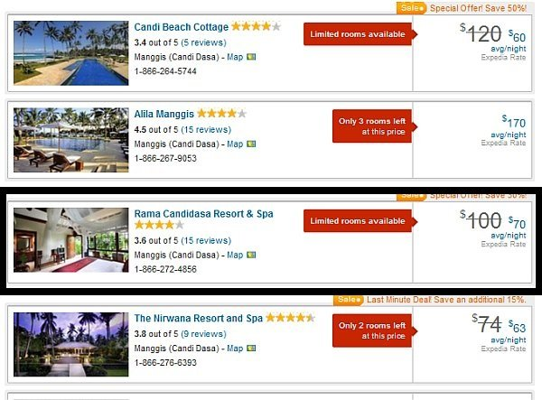

Problem Statement:
IDEA TWO: Expedia Hotel Recommendation
Goal: predict the likelihood of a user to stay at one of the 100 Expedia hotel groups
In-house algorithm to form the 100 hotel clusters to group similar types of hotels for providing recommendations to users searching for hotels
Timeframe: Year of 2013 to 2015 (2013 - 2014 data for training, 2015 data for testing)
Dataset:
Below are the fields in the data set:
Datetime, sitename, user location, distance between user and destination, user id, mobile sessions?, Package booking?, marketing channel, check-in & check-out date, adult count, children count, room count, destination type, hotel location, is booking?, hotel cluster
Solution:
Classification Model
Notes:
Datetime, sitename, user location, user_destination_distance, user id, mobile sessions?, Package booking?, marketing channel, check-in & check-out date, adult count, children count, room count, destination type, hotel location, is booking?, hotel cluster

Slide 4
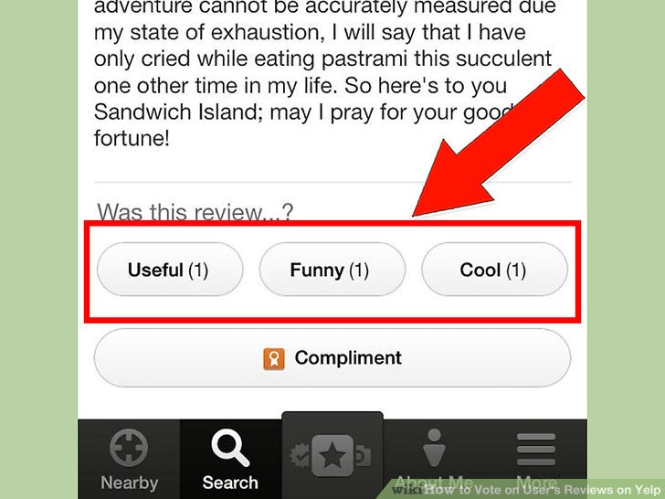

Problem Statement:
Dataset:
IDEA THREE: How “useful” is a Yelp review?
Goal: Predict the best quality review based on the historical data
Yelp’s 3 community-powered metrics of review quality: Useful, Funny and Cool
A good review accumulates lots of votes in these categories from community over time.
1/19/2013 to 3/12/2013
Below are the fields in the four data sets provided by Yelp:
Business Data: business Id, business name, location, neighborhood, stars, review count, categories
Review Data: Date, user id, business id, review text, votes (‘useful’ count, ‘funny’ count & ‘cool’ count)
User Data: User id, review count, average star, votes count
Business Check-in Data: Business id, checkin info (count and time of check-in)
Solution:
Multivariate Regression Model
Notes:
How many “useful” votes will a Yelp review receive?
Problem Statement:
Yelp has 3 community-powered metrics of review quality: Useful, Funny, Cool.
Over time, a good review about a business will accumulate lots of votes in these categories from community. Instead of waiting for the votes from the community, Yelp would like to create a predictive mode to detect in advance the high quality review.
Objective:
Predict the best quality review based on the historical data available and understand how these good reviews look like
Timeframe of the analysis:
From 2013-1-19 to 2013-3-12
(2013-1-19 for the training dataset, 2013-01-19 and 2013-03-12 for the testing dataset)
Dataset:
Business Data: Business Id and business name, location, neighborhood, starts, review count, categories
Review Data: Date, user id, business id, review text, votes (useful count, funny count & cool count)
User Data: User id, reivew count, average star, votes count
Checkin Data: Business id, checkin info (count and time of checkin)

